Slide 1
Chapter 1
Measurement
Notes:
1

Slide 2
1-1 Measuring Things, Including Lengths
Learning Objectives
1.01 Identify the base quantities in the SI system.
1.02 Name the most frequently used prefixes for SI units.
1.03 Change units (here for length, area, and volume) by using chain-link conversions.
1.04 Explain that the meter is defined in terms of the speed of light in a vacuum.
Notes:
2

Slide 3
1-1 Measuring Things, Including Lengths
Science is based on the precise measurement and exploration of physical phenomena described by physical quantities. We discover science by learning how to measure these quantities (length, mass, time, pressure, temperature,…). Physics (most basic of the sciences)
Therefore, we need:
Rules for measurement and comparison
Units for measurement
A unit:
Is the unique name (kg, second, meter, Pascal, etc.) assigned to the measure of a quantity (mass, time, length, pressure, etc.) by comparison with a standard.
Standard corresponds to exactly 1.0 unit of the quantity (e.g. standard for length is 1.0 meter; any other length whatsoever must now be expressed in terms of that standard)
Notes:
3

Slide 4
1-1 Measuring Things, Including Lengths
There are many different physical quantities, but not all are independent: distance vs. speed (distance/time)
Base quantities (international agreement):
Are seven fundamental quantities such as length, time
Three are needed for mechanics: length, time, mass
All have been assigned standards
Are used to define all other physical quantities
Base standards must be:
Accessible, so precise measurements can be taken
Invariable, so measurements do not change over time
Notes:
4

Slide 5
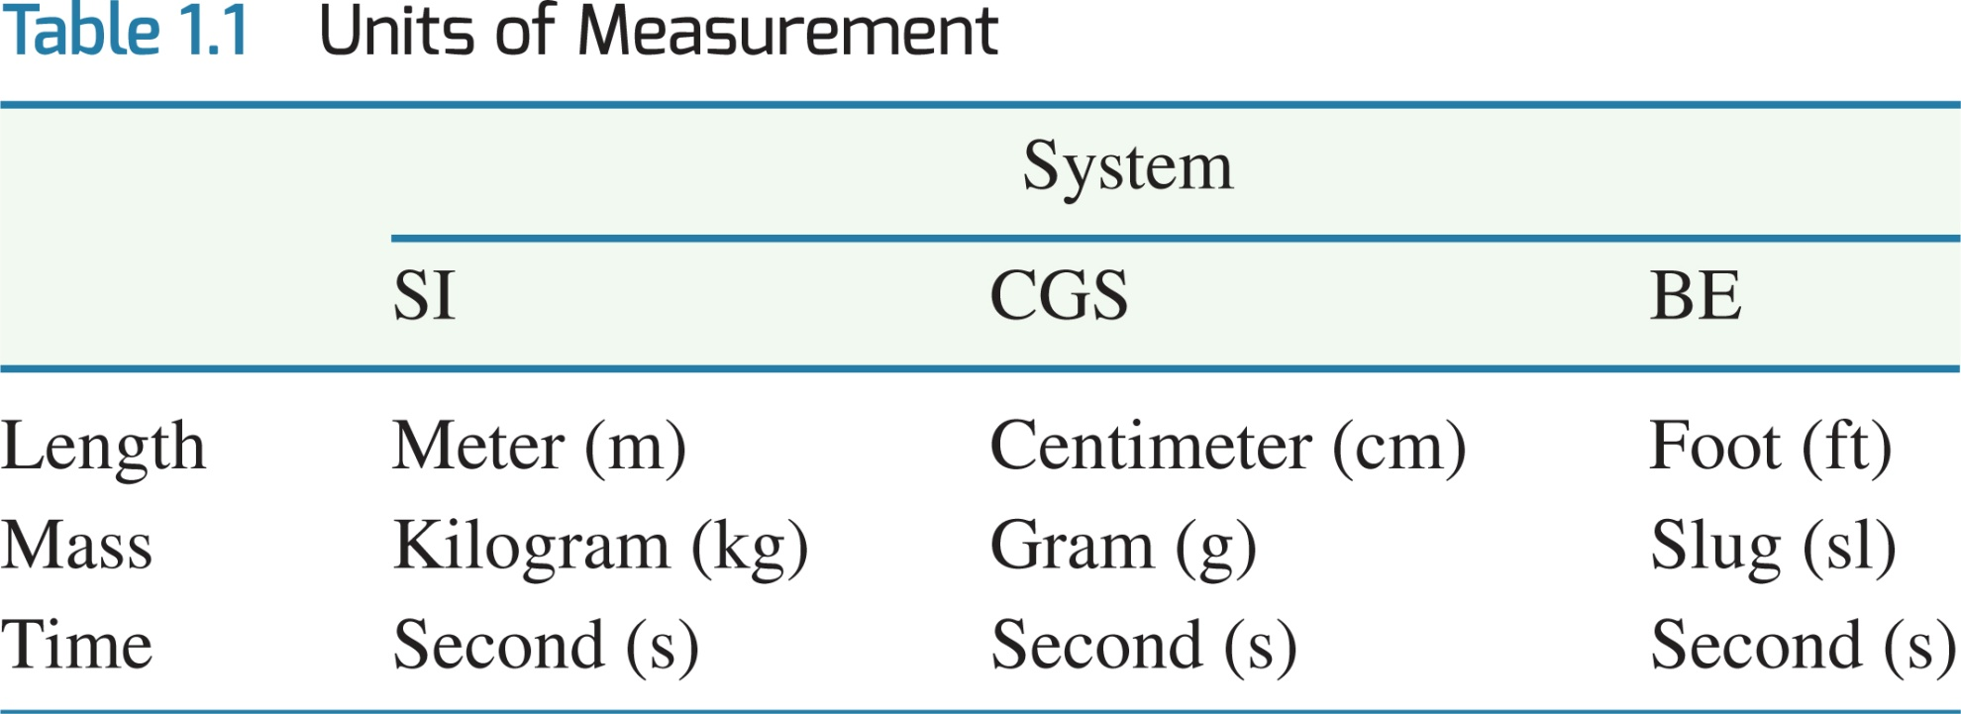
1-1 Measuring Things, Including Lengths
SI units (the metric system) form the International System of Units (agreed upon in 1971, consisting of seven quantities: m, Kg, s, A, K, mol, cd)
SI base units include
Meters (length)
Seconds (time)
Kilograms (mass)
SI has many derived units, which are written in terms of base units
Joules (work-energy): 1 J = 1 kg m²/s²
Watts (power): 1 W = 1 J/s = 1 kg m²/s³
Notes:
5

Slide 6
1-1 Measuring Things, Including Lengths
Scientific notation employs powers of 10 to write large or small numbers ( also written as E9, E-7 on most calculators)
A conversion factor (changing unit is often needed!)
A chain-link conversion method: multiply the original measurement by a conversion factor (a ratio of units that is equal to 1) to cancel unwanted units
Used to convert between units
Units obey the same algebraic rules as variables and numbers
Notes:
6

Slide 7
1-1 Measuring Things, Including Lengths
Reasoning Strategy: Converting Between Units
1. In all calculations, write down the units explicitly.
2. Treat all units as algebraic quantities. When identical units are divided, they are eliminated algebraically.
3. Be guided by the fact that multiplying or dividing an equation by a factor of 1 does not alter the equation.

Slide 8
1-1 Measuring Things, Including Lengths
Examples Chain-link conversions:
1.3 km x (1000 m)/(1 km) = 1300 m = 1.3 x 10³
0.8 km x (1000 m)/(1 km) x (100 cm)/(1 m)
= 80 000 cm = 8 x 10⁴
2845 mm x (1 m)/(1000 mm) x (3.281 ft)/(1 m) = 9.334 ft
1 ft = 0.3048 m
1 mi = 1.609 km
1 hp = 746 W
1 liter = 10⁻³ m³

Slide 9
1-1 Measuring Things, Including Lengths
Needs for accuracy and precisions in science have driven changes in the standards for units
In the past, 1 meter has been defined by:
One ten-millionth of the distance from the North pole to the equator
Later, for practical reasons, a platinum-iridium standard meter bar kept in France
In 1960, 1 650 763.73 wavelengths of an emission line of Kr-86
Today,
In each transition, the new distance was chosen so that the approximate length of 1 meter was preserved
Notes:
9

Slide 10
1-1 Measuring Things, Including Lengths
Significant figures are meaningful digits whose values are known with certainty: 1.78 m vs 1.780 m;
In general, trailing zeros are not significant
In other words, 3000 may have 4 significant figures
but usually 3000 will have only 1 significant figure!
When in doubt, use scientific notation 3.000 x 10³ (4 significant figures) or 3 x 10³ (1 significant figure)
Generally, round to the least number of significant figures of the given data
25 x 18 = 450 → 2 significant figures;
25 x 18.975 = 474.375→ the final answer should consist of only 2 significant figures → 470
Significant figures are not decimal places
0.00356 has 5 decimal places, 3 significant figures 3.56 x 10-³

Slide 11
1-1 Measuring Things, Including Lengths
As a rule, when numbers are multiplied or divided, the number of significant figures in the final answer equals the smallest number of significant figures in any of the original factors.
As a rule, when numbers are added or subtracted, the last significant figure in the final answer occurs in the last column containing a number that results from a combination of digits that are all significant.
2.5 + 11 + 5.26 = 18.76 → 19

Slide 12
1-2 Time
Any standard of time needs to be able to answer:
When did a thing happen?
What was its duration?
Times follow the same conversion process as lengths
Standards of time in the past have included (any phenomenon that repeats itself is a candidate):
Average time for the Earth to rotate once: 1 day being set to 86,400 seconds
Quartz clock (piezo-electric material that uses an electronic oscillator that is regulated by a quartz crystal to keep time)
Cesium Atomic clocks (uncertainty of 1 sec in 60 millions years)
Notes:
12

Slide 13
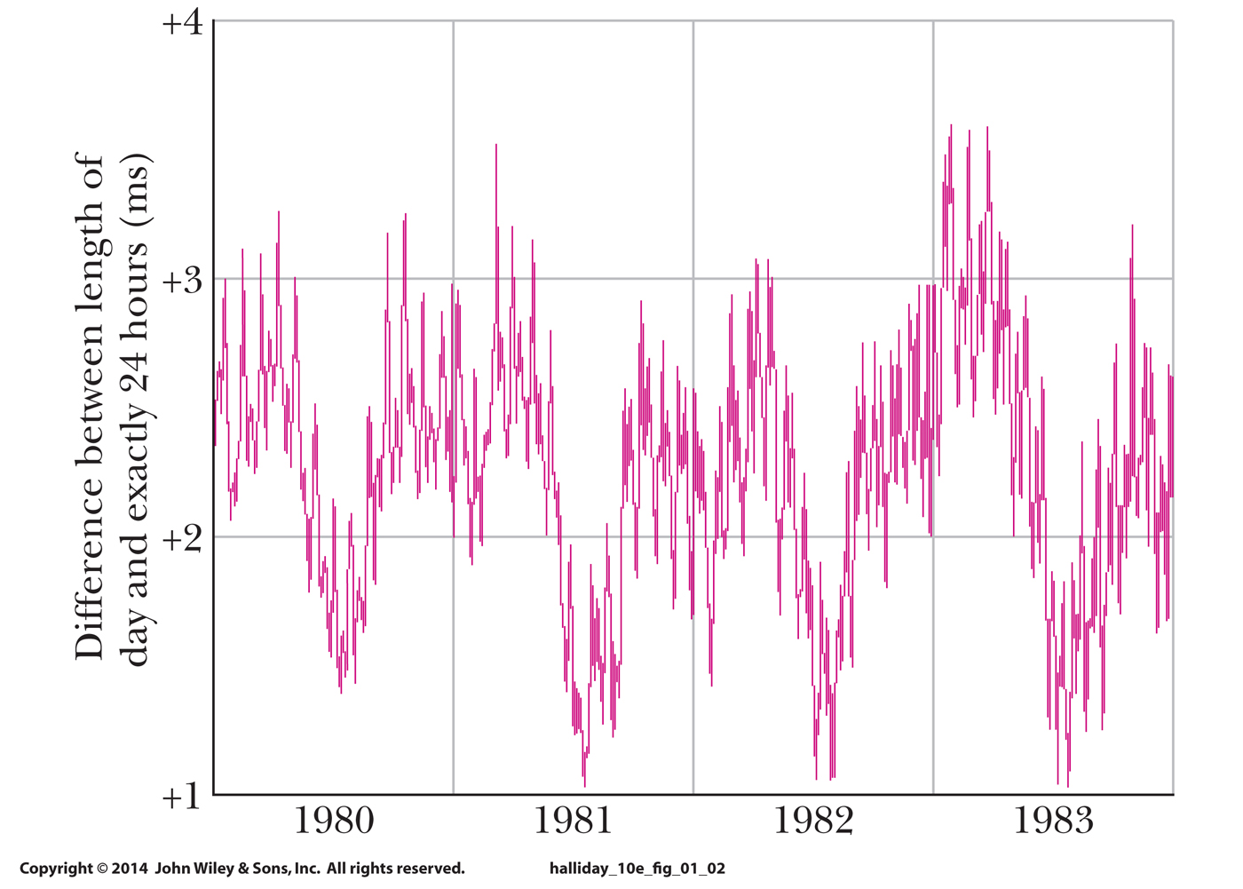
1-2 Time
The variation in the length of a day as measured by an atomic clock:
The vertical scale here amounts to only 3 ms, or 0.003 s.
This shows the precision of atomic clocks, and the relative imprecision of Earth's rotation (affected by tides, winds)
Figure 1-2
Notes:
13

Slide 14
1-3 Mass
The standard kilogram is a cylinder of platinum and iridium stored in France.
Accurate copies have been sent around the world, other masses can be measured by comparing them against these copies
The atomic mass unit (u) is a second mass standard
1 atom of Carbon-12 is assigned a mass 12 u (international agreement)
Used for measuring masses of atoms and molecules
1 u = 1.660 538 86 x 10⁻²⁷ kg (+/- 10 x 10⁻³⁵ kg)
Masses follow the same conversion process as lengths and times
Notes:
14

Slide 15
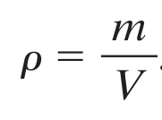
1-3 Mass
For uniformly (homogeneous) system, we define the Mass per unit volume of that system to be the density
Eq. (1-8)
Examples Calculate . . .
Density of material: (18 kg) / (0.032 m³) = 560 kg/m³
Mass of object: (380 kg/m³) x (0.0040 m³) = 1.5 kg
Volume of object: (250 kg) / (1280 kg/m³) = 0.20 m³
Notes:
15

Slide 16
1 Summary
Measurement
Defined by relationships to base quantities
Each defined by a standard, and given a unit
SI Units
International System of Units
Each base unit has an accessible standard of measurement
Changing Units
Use chain-link conversions
Write conversion factors as unity
Manipulate units as algebraic quantities
Length
Meter is defined by the distance traveled by light in a vacuum in a specified time interval
Notes:
16

Slide 17
1 Summary
Time
Second is defined in terms of oscillations of light emitted by a cesium-133 source
Atomic clocks are used as the time standard
Mass
Kilogram is defined in terms of a platinum-iridium standard mass
Atomic-scale masses are measured in u, defined as mass of a carbon-12 atom
Density
Mass/volume
Eq. (1-8)
Notes:
17

Slide 18
DIMENSIONAL ANALYSIS
All physical quantities are expressed by specifying both a number and a unit. Dimension refers to the physical nature of a physical quantity and the type of unit used to specify it.
DIMENSIONAL ANALYSIS
Distance has the dimension of length, [L]
Dimension of mass is [M]
Dimension of time is [T]
Many physical quantities (derived units) are in terms of a combination of fundamental dimensions (base units) such as [L], [M], and [T]

Slide 19
DIMENSIONAL ANALYSIS
DIMENSIONAL ANALYSIS is used to check mathematical relations for the consistency of their dimensions
Is the following equation dimensionally correct?

Slide 20
DIMENSIONAL ANALYSIS
Is the following equation dimensionally correct?
DIMENSIONAL ANALYSIS alone can not identify the correct the relation

Slide 21
